Slide 1
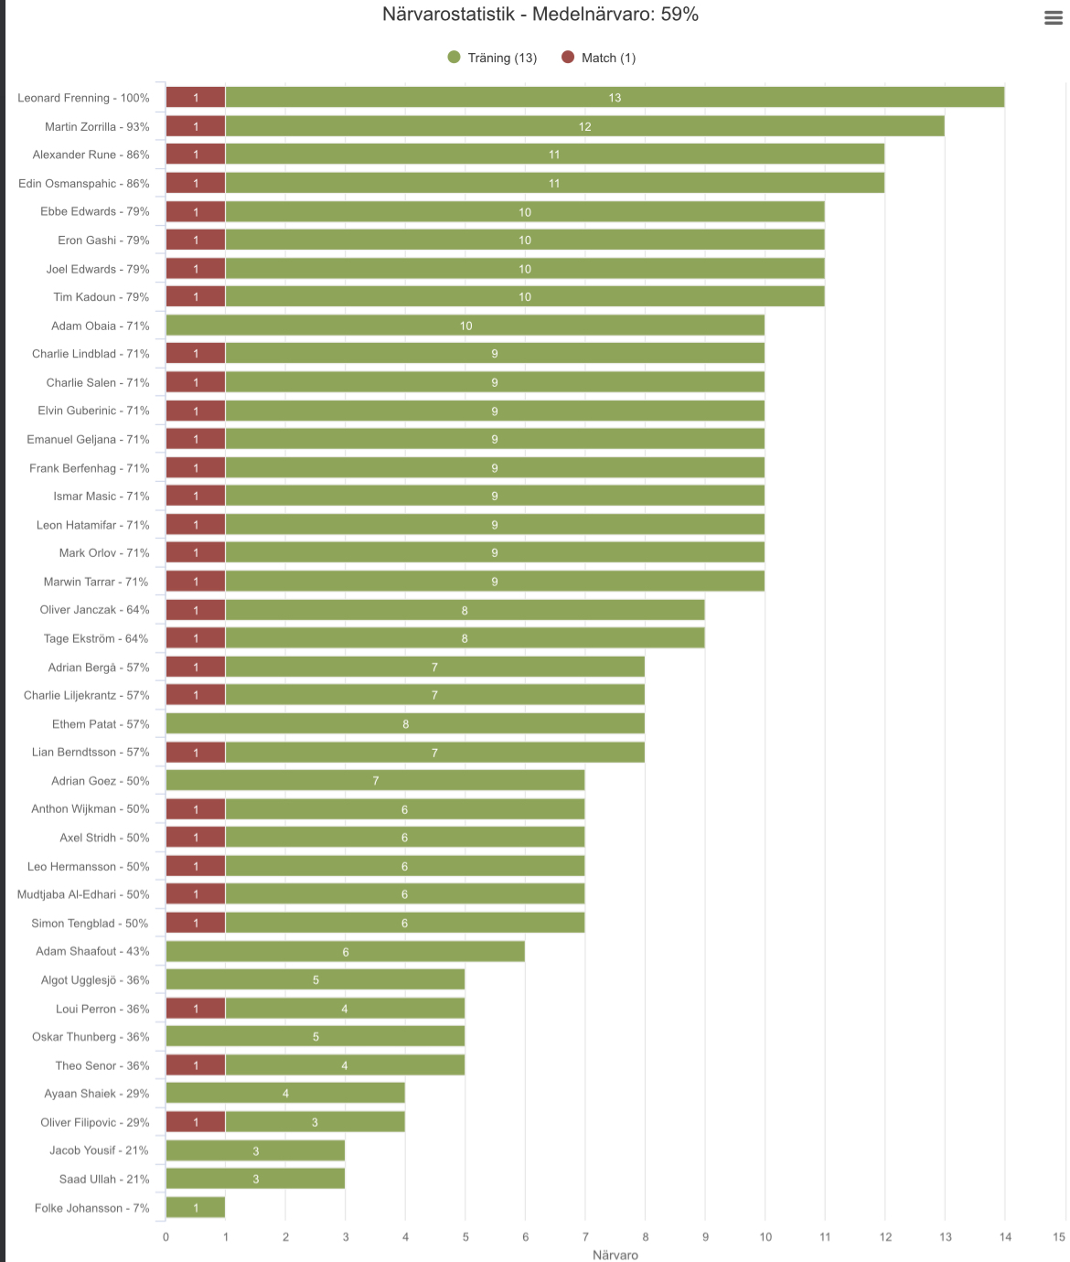
Lag Blå: Marcus
Leonard
Alexander
Ebbe
Eron
Joel
Tim
Lag Svart: Antonio
Martin
Adam O
Charlie S
Elvin
Ismar
Leon
Lag Grön: Patrik & Robert
Charlie L
Mark
Adrian
Charlie Lilj
Ethem
Lian
Reserv 2
Lag orange :Bassam
Emanuel
Adrian
Axel
Simon
Adam
Loui
Reserv 3
Reserv 4
Lag röd: Sher
Marwin
Oskar
Theo
Oliver
Saad
Folke
Reserv 1
Deltar ej =

