Slide 1
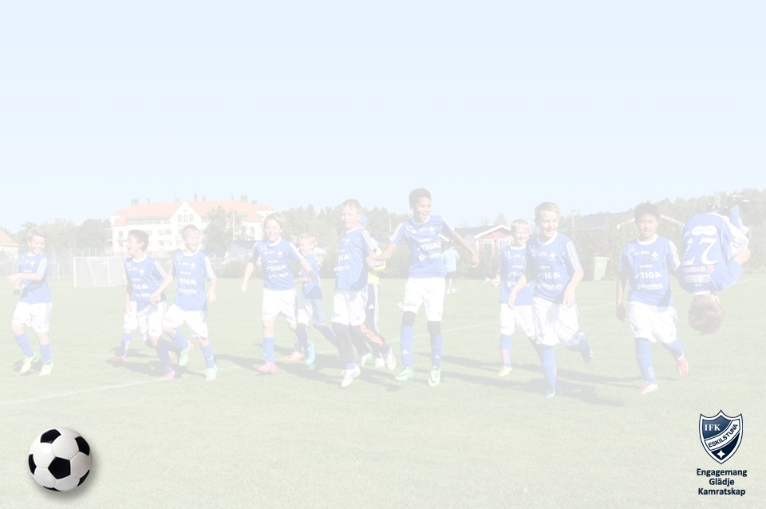
Årsplanering 2023
IFK Eskilstuna serveringsveckor
Vårveckor Lag Höstveckor
v. 18 (01/5 – 07/5) IFK P 17
v. 19 (08/5 - 14/5) IFK P 16
v. 20 (15/5 – 21/5) IFK P 15 v. 31 (31/7 – 06/8)
v. 21 (22/5 - 28/5) IFK P 14 v. 32 (07/8 – 13/8)
v. 22 (29/5 – 04/6) IFK P 13 v. 33 (14/8 – 20/8)
v. 23 (05/6 – 11/6) IFK P 12 v. 34 (21/8 – 27/8)
v. 24 (12/6 – 18/6) IFK P 11 v. 35 (28/8 – 03/9)
v. 25 (19/6 – 25/6) IFK P 10 v. 36 (04/9 – 10/9)
v. 26 (26/6 – 02/7) IFK P 9 v. 37 (11/9 – 17/9)
v. 27 (03/7 – 09/7) IFK P 8 v. 41 (09/10 – 15/10)

Slide 2
Årsplanering 2022
IFK Eskilstuna serveringsveckor
Höstveckor Lag Höstveckor
v. 38 (18/9 – 24/9) IFK P 7
v. 39 (25/9 – 01/10) IFK F 8-9
v. 40 (02/10 – 08/10) IFK F 7

